Slide 1
Air Quality Monitoring
Presentation to the Penrice Mine Community Consultation Group
Date:
Name:
Position:
[28/10/2025]
Dr. Mohammad Iqbal
Senior Scientific Officer, Air Quality

Slide 2
Acknowledgement of Country
I would like to acknowledge the traditional owners of the land on which we meet today and pay my respects to their Elders past and present and extend that respect to other Aboriginal and Torres Strait Islander people who are present today.
Artwork: 'Caring for Country', courtesy of Arrernte man Scott Rathman

Slide 3
Overview
    What is air pollution?
    Where does air pollution come from?
    Why do we monitor air pollution?
    What does EPA do?
    What does EPA not do?
    Where does EPA do air monitoring?
    What does EPA do with the data?
    How can I find out more?

Slide 4
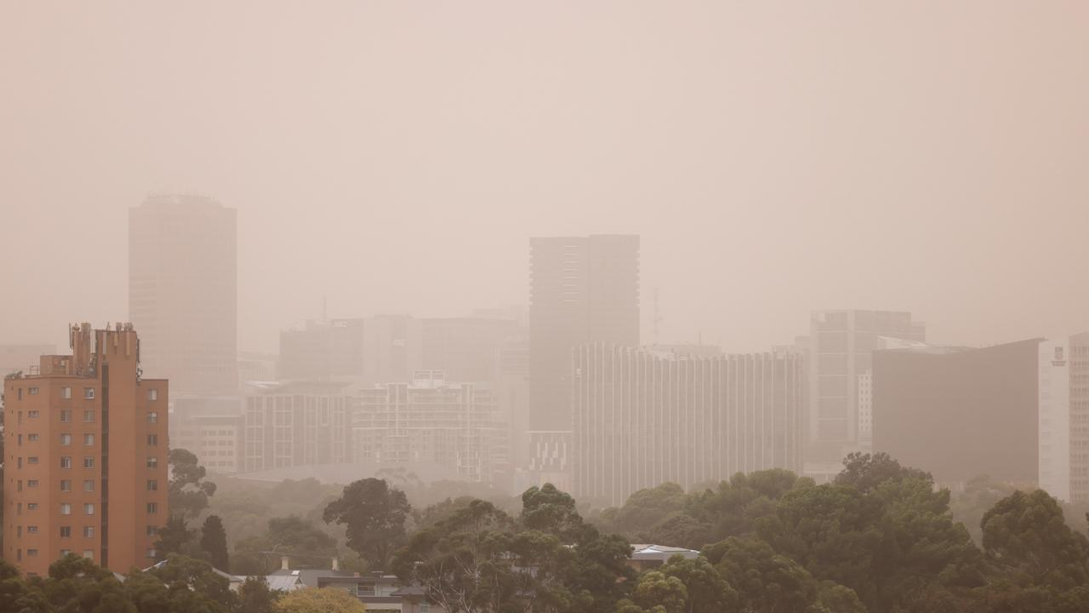
What is air pollution?
    Contamination of the indoor or outdoor environment by any chemical, physical or biological agent that modifies the natural characteristics of the atmosphere.
    Air pollution
    Adelaide: Dust storm envelopes city, two hospitalised as visibility ‘practically zero’ | news.com.au — Australia’s leading news site for latest headlines

Slide 5
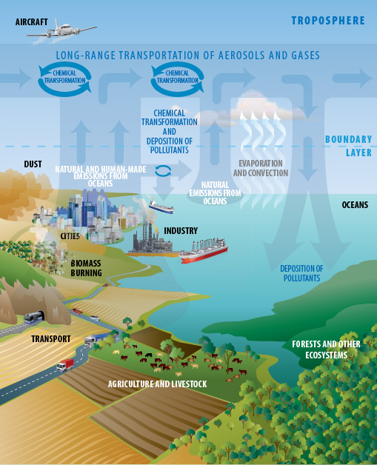
Where does air pollution come from?
    Industry
    Agriculture and livestock
    Mining and quarry activities
    Fires
    Vehicles
    Human-made sources
    Natural sources

Slide 6
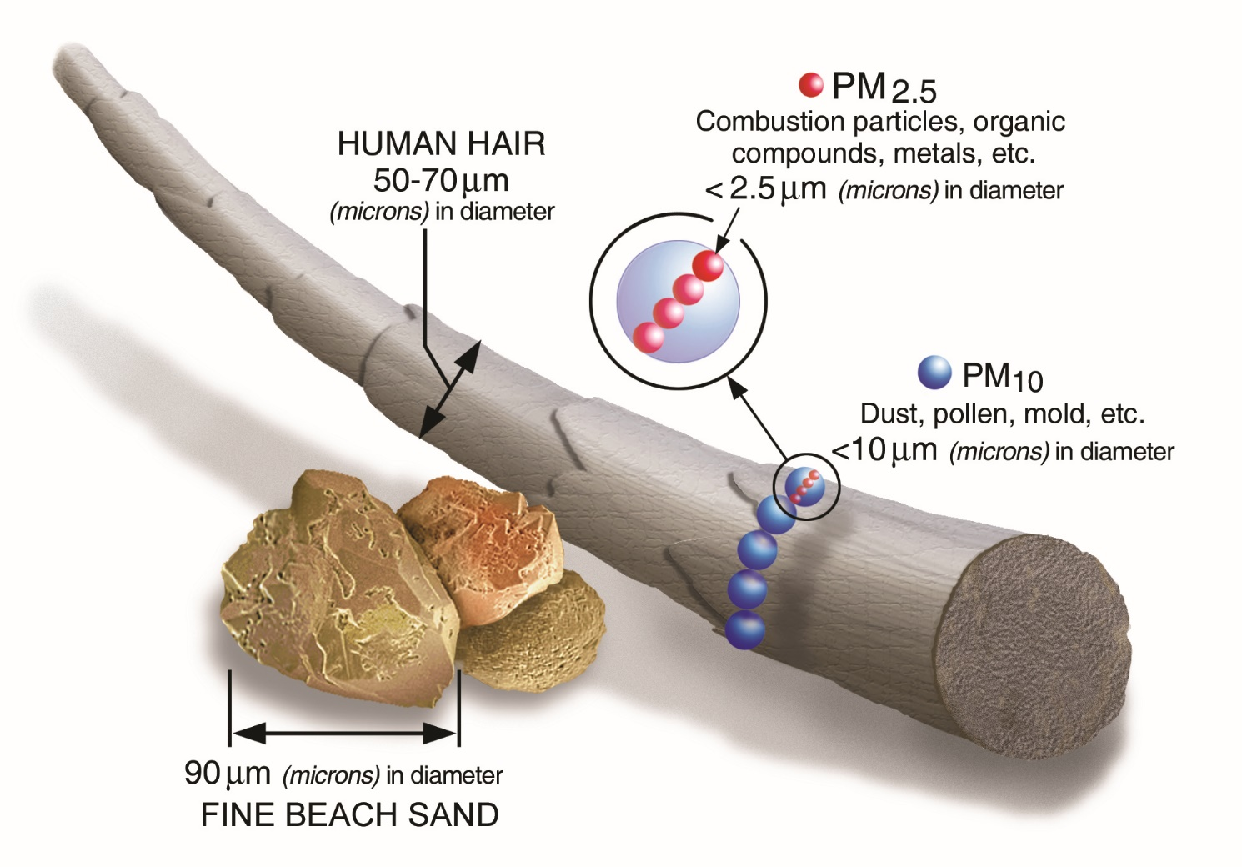
Particulate Matter
TSP: Total Suspended Particulates includes all airborne particles, from the very fine up to larger, visible dust particles up to ~100 µm in diameter (PM₁₀₀)
PM₁₀ – Up to 10 µm (fraction of TSP)
PM_{2.5} - Up to 2.5 µm (fraction of TSP)
PM₁₀ and PM_{2.5} have adverse health impacts
Larger particles (>PM₁₀) are generally trapped in our noses and throats, so they do not reach the lungs; however, they may cause irritation, nuisance and soiling of surfaces.
TSP is also referred to as “nuisance dust”.

Slide 7
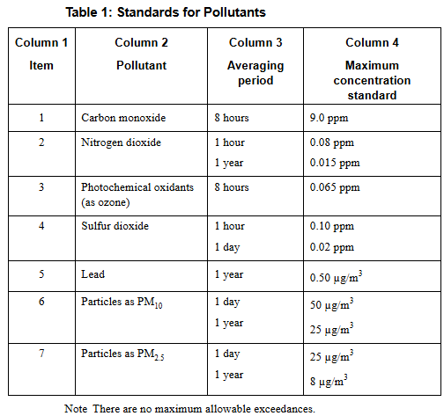
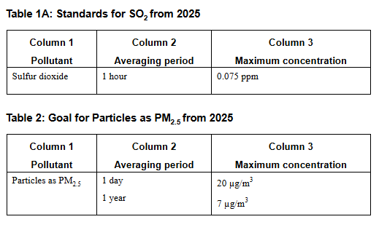
Why do we monitor air pollution?
Ambient air quality monitoring requirements are outlined in the National Environment Protection (Ambient Air Quality) Measure (NEPM), including:
        the population threshold for monitoring requirements
        air quality standards for pollutants based on health risk assessments

Slide 8
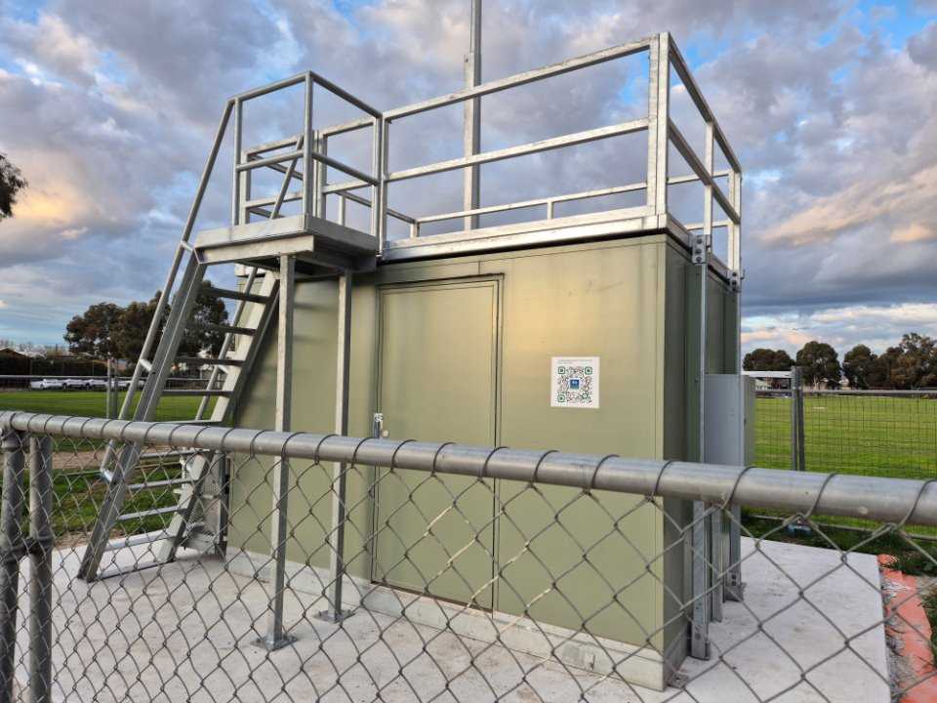
What does EPA do?
Ambient air monitoring
Limited campaign monitoring
Emergency response monitoring

Slide 9
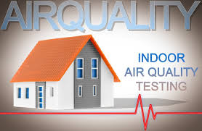
What does EPA not do?
Industrial fence line monitoring
Ambient asbestos in air monitoring
Indoor air quality monitoring
Residential outdoor air quality monitoring

Slide 10
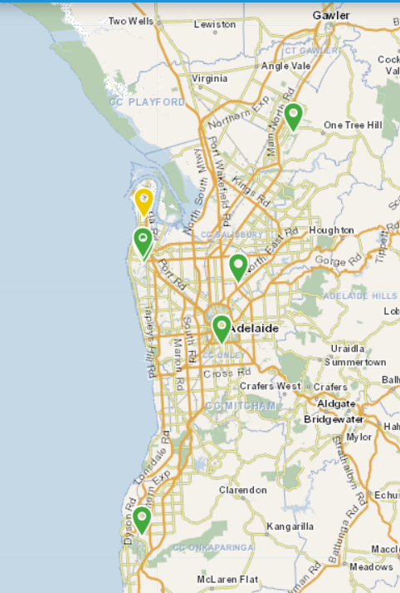
Where does EPA monitor?
Greater Adelaide Region
Elizabeth
Northfield
CBD
Birkenhead
North Haven
Cowandilla
Christies Beach
*update map once Cowandilla is online

Slide 11
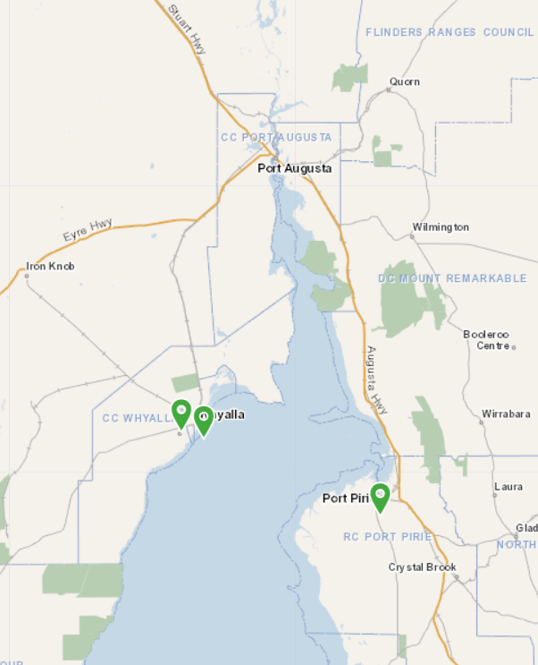
Where does EPA monitor?
Regional South Australia
Whyalla
Pt Pirie

Slide 12
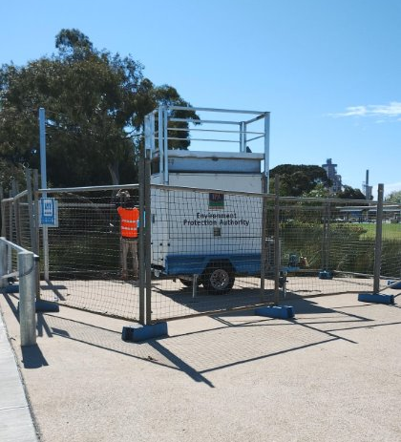
Where does EPA monitor?
Current Campaign Monitoring
Mobile station – Sellicks Beach
This monitoring campaign will begin in November 2025 and will continue for 12 months.

Slide 13
Why does EPA monitor at these locations?
EPA monitors at these locations for a number of reasons including:
    Number of people in region
    Presence of major industry or other pollution source
    Siting criteria standards
    Access to power

Slide 14
What does EPA do with the data?
The data collected by EPA is used in a number of ways:
    Displayed in near real time of the SA EPA website to allow access to the general public
    Used to generate the air quality categories in near real time
    Generate air monitoring reports and trend analysis for interested stakeholders and the public
    Used to help assess licensee compliance with regulatory requirements
    Shared with other government agencies to help support their functions (i.e. SA Health and assessing health impacts)

Slide 15
Thank you
Environment Protection Authority
  211 Victoria Square
  Tarntanyangga, Kaurna Country
  Adelaide SA 5000

